Slide 1

SECTION 1: FUNDAMENTALS OF HARDWARE AND SOFTWARE
Objective1.5:
Compare the types of secondary storage media:
Portability
Speed
Capacity.

Slide 2
Secondary Storage Devices are chosen based on
Storage capacity (how much data the device can store)
Access speed ( the time needed to locate the data and transmit it to the CPU)
Portability ( ability to be easily removed and used on another system)
Cost
Size (necessary for storage on shelves or portability)

Slide 3
Magnetic Tape
A magnetic tape looks like an audiocassette tape.
Tapes may come in different sizes.
It is used mainly to backup hard disks because it can store large amounts of data at a low cost.
Accessing data on a tape is very slow since data is stored sequentially.
Sequentially means that data is retrieved in the order which it was stored.
As of 2008, the highest capacity tape cartridges can store 1 TB of data.
A tape drive is used to read data from and write data to the tape.
The tape drive may be external or built into the system unit.

Slide 4
Magnetic disks (Floppy disk, Hard disk)
All magnetic disks provide direct access to stored data. This means that you can go directly to specific piece of data without having to access any other either before or after the data you want.

Slide 5
Floppy disk
This is also called a diskette.
It is a removable, flexible plastic disk, coated with a magnetizable material.
The disk is held in a plastic case, usually 3.5 inches by 3.5 inches in dimension.
The plastic case protects the disk from dust and grease.
The floppy disk is used to store and transfer small amounts of data between computers.
A 3.5 inch floppy disk holds up to 1.44 MB of data.

Slide 6
Floppy disk
Data and information is written to or read from the disk by a read/write head in the disk drive held in the system unit.
Data is stored on both sides of a diskette on tracks and sectors. Tracks are a set of numbered concentric rings.
The tracks are also divided into wedge shaped pieces known as sectors, which are also numbered.
A sector is the amount of data that can be read from or written to a disk by the computer in one read/write operation.
Sector
Track

Slide 7
Floppy disk
Before data is stored on a floppy disk, it needs to be formatted.
Formatting means writing electronic information on the disk so that the computer can recognize the disk as a valid storage device where data can be stored.
Most floppy disks are already formatted when they are purchased.
If a diskette is formatted after data has been stored to it, the information will be deleted.

Slide 8
Hard disk
A hard disk is a thin but rigid, inflexible disk made of highly polished metal.
The surface of each side of the disk (also called platters) is covered with a substance that can be magnetized.
As of April 2009, the highest capacity HDDs is 2 TB.
There are different types of disk: moveable head, fixed head and external.
Moveable head hard disks have one read/write head per disk.
Fixed head disks have a read/write head for every track on the disk.

Slide 9
Hard disk
The access time (time to get data) from a spinning disk with one read/write head is a combination of:
Seek time – how long it takes the head to get to the right track;
Rotational delay or latency time – how long it takes for the data to rotate under the head; and
Transmission time – the time taken to read the data and transmit it to the CPU.

Slide 10
Hard disk
The access time for a fixed disk is less than that of a moveable disk, since each track has a read/write head and this eliminates the seek time.
The external and removeable hard disks are portable hard disks that are connected to the system unit.
External hard disks have very large storage capacities, up to 1.5 TB currently.
They are used mainly by very large computers.
Hard disks are more reliable than floppy disks since its platters are fixed and seal in a unit.
Hard disks can store much more data than floppy disk and optical disks and access and transmission of data is faster.

Slide 11
Hard disk
Like floppy disks, a hard disk must also be formatted before any data can be stored on it.
Formatting sets up the tracks, sectors and cylinders.
A cylinder is made up of all the tracks of the same number from all the disks that make up the hard disk.

Slide 12
Optical Disk
Optical disks are disks that are read by laser lights.
They are made from plastic.
The data is stored on layers inside the plastic.
CDs and DVDs are the two main types of optical disks.

Slide 13
Compact Disk
A Compact Disc (CD) is an optical disc used to store digital data.
The physical dimension of a CD is 12 cm or occasionally 8 cm in diameter.
CDs can hold up to 750 MB. They are three types of CDs: CD-ROM, CD-R and CD-RW.

Slide 14
Compact Disk Variations
CD-ROM (Read only)
CD-R (Recordable)
CD-RW (Rewritetable)

Slide 15
CD-ROM (read only)
Stores multimedia (text, graphics, sound and videos).
Stores software packages for sale or distribution e.g application software packages such as encyclopedias, word processors, training programs, games and graphics packages.

Slide 16
CD-R (Recordable)
Stores large volumes of data that does not need to change e.g music CDs.
CD-RW (Re-Writeable)
Storing large volumes of data that change frequently e.g backups copies

Slide 17
DVD
Digital Versatile Disc" commonly called “DVD” is an optical disc storage media that can be used for storing movies with high video and sound quality.
DVDs look like compact discs; their physical dimensions are the same (12 cm or occasionally 8 cm in diameter).
DVDs are encoded in a different format to CDs, and they have a much higher density (more data is stored per unit area).
Some DVDs are double sided i.e., they can hold data on both sides.
DVDs can hold between 4.7 GB and 17 GB of data. Three types of DVDs are the DVD-ROM (read only), DVD-R (recordable) and DVD-RW (rewritable).

Slide 18
USB Flash drive
USB Flash drives are storage devices which consist of a small circuit board encased in a plastic or metal casing built with a USB interface.
They are typically small, lightweight, removable and rewritable.
As of November 2006, to present, memory capacities for USB Flash drives range from 32 MB up to 64 GB.
Flash drives are more compact, generally faster, hold more data and may be more reliable (due to their lack of moving parts) than floppy disks.

Slide 19
Uses of Flash Drives
Personal data transport
The most common use of flash drives is by individuals to transport and store personal files such as documents, pictures and video.
Computer repair
Flash drives are used to transfer recovery and antivirus software to infected PCs.
System administration
Flash drives are used by system and network administrators, who load them with configuration information and software used for system maintenance, troubleshooting, and recovery.
Application carriers
Flash drives are used to carry applications that run on the server computer without requiring installation.

Slide 20
Flash Memory Cards
These come in the form of a card shaped like a stick of chewing gum, with dimensions 21.5 x 50 x 2.8 mm and storage capacities up to 64 GB.
They are a special type of EEPROM that can be erased and reprogrammed in blocks instead of one byte at a time.
They are used in PDAs (personal digital assistants), laptop computers, digital audio players, digital cameras, mobile phones and video game consoles.

Slide 21
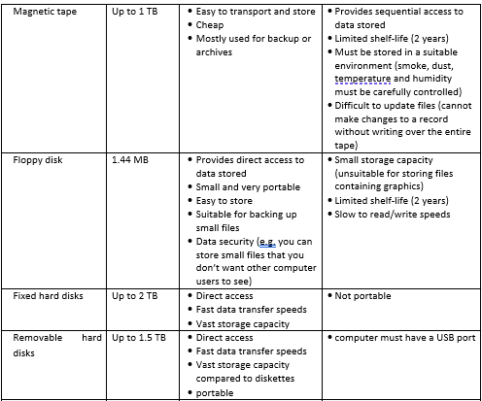
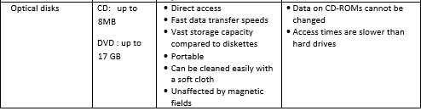
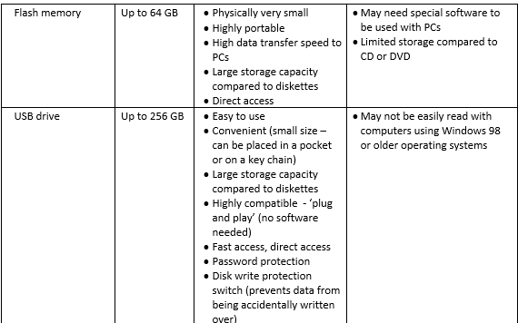
Storage Device – Capacity, Advantages and Disadvantages

Slide 22
Flash Memory Cards
These come in the form of a card shaped like a stick of chewing gum, with dimensions 21.5 x 50 x 2.8 mm and storage capacities up to 64 GB.
They are a special type of EEPROM that can be erased and reprogrammed in blocks instead of one byte at a time.
They are used in PDAs (personal digital assistants), laptop computers, digital audio players, digital cameras, mobile phones and video game consoles.

